Slide 1
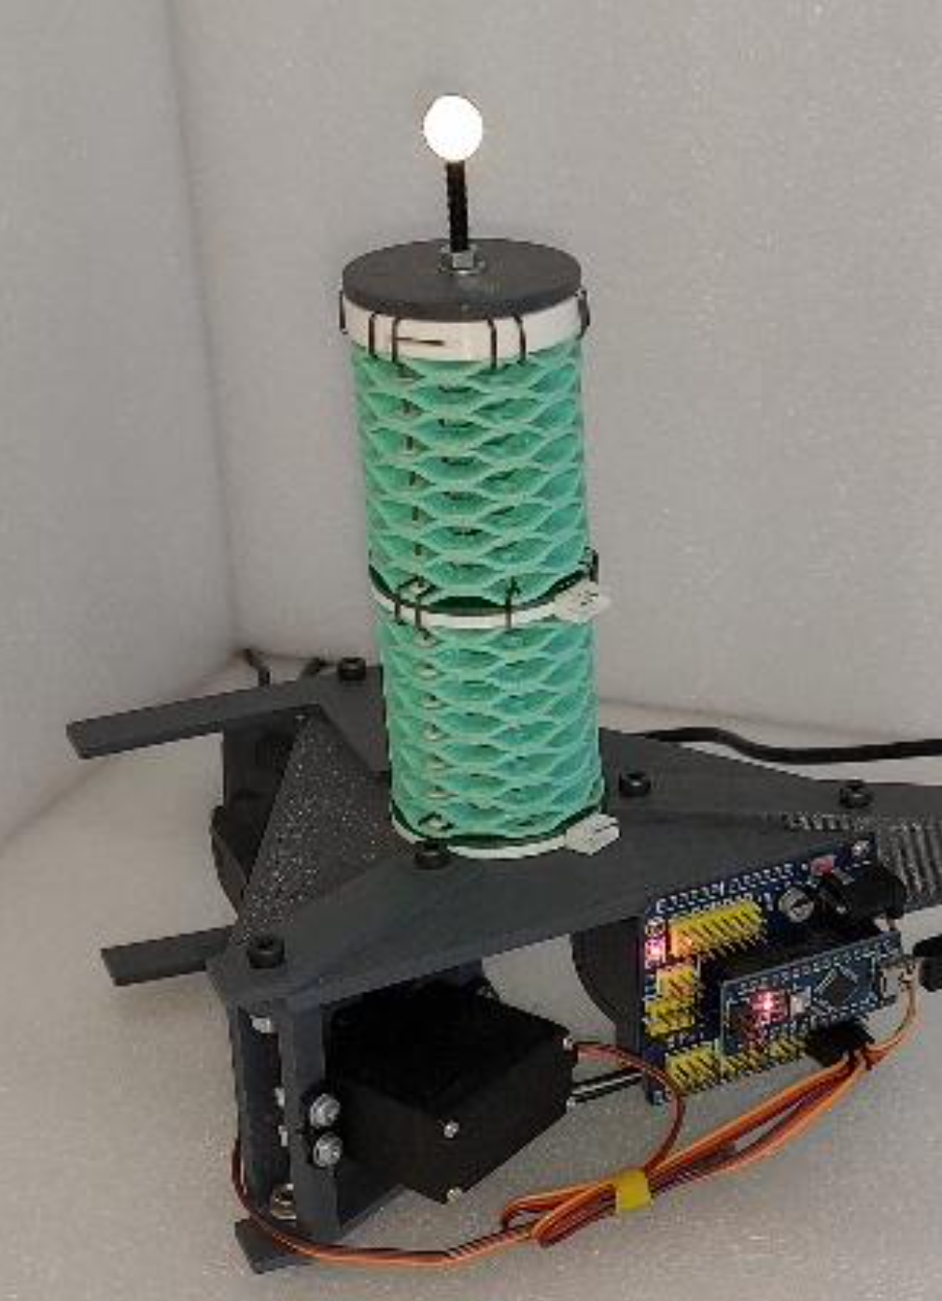
End-point position estimation of a soft continuum robot joint using magnetic sensors
Intelligent systems 22/10/2025
by Group 11
Diogo João Mendes Pereira (ISTID 87172)
Margarida do Rio Filipe Nabais (ISTID 113219)

Slide 2
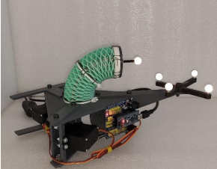
Objective and methodology
Takagi-Sugeno
ANFIS
MLP

Slide 3
Takagi-sugeno model
Feature engineering:
- Feature Selection
- Dimensionality Reduction
Training:
- Validation set and standardization
- Parameter tuning
- Cross validation

Slide 4
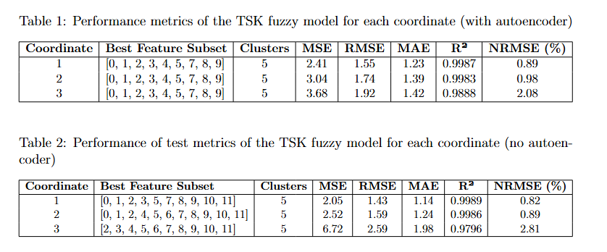
TSK Results

Slide 5

Anfis Results

Slide 6
MLP Models
Feature Selection Experiments
Produced simillar or even worse results than using all the variables
All 12 features were used
Grid Search with Cross-Validation
Produced similar results to a regular grid search with higher computational cost

Slide 7
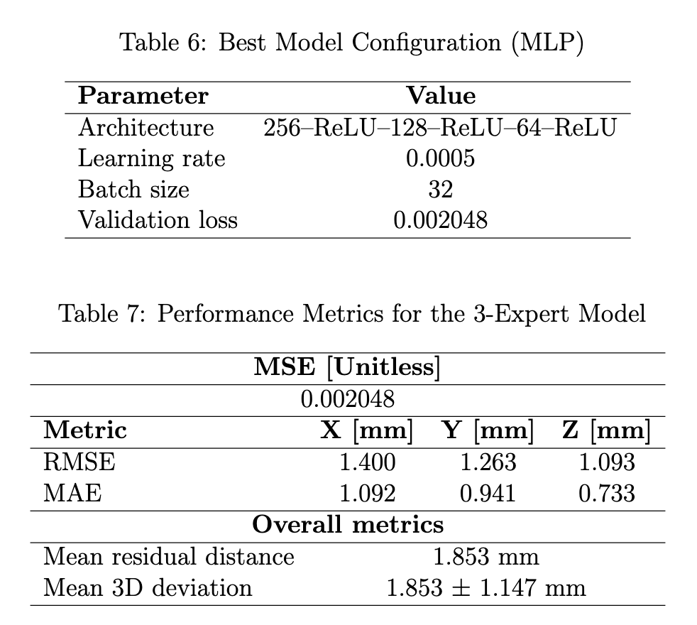
MLP Results

Slide 8
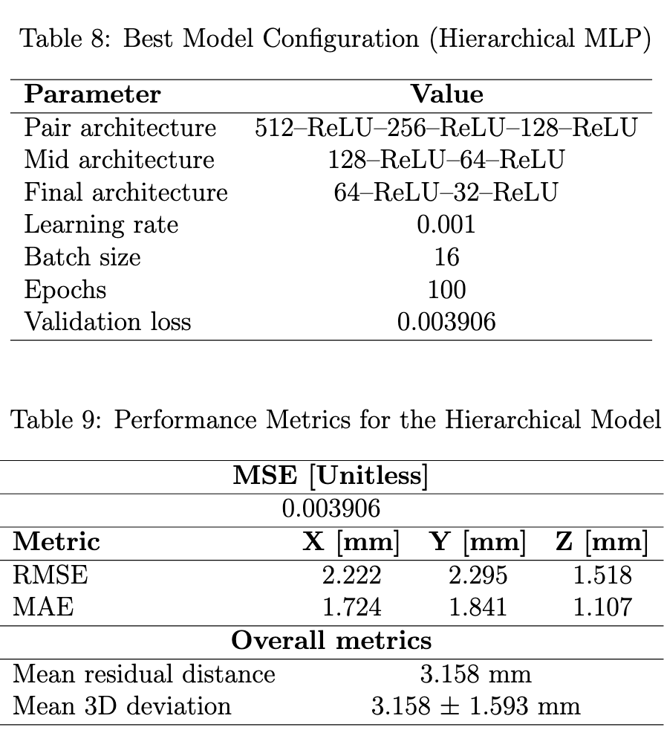
Hierarchical Models

Slide 9
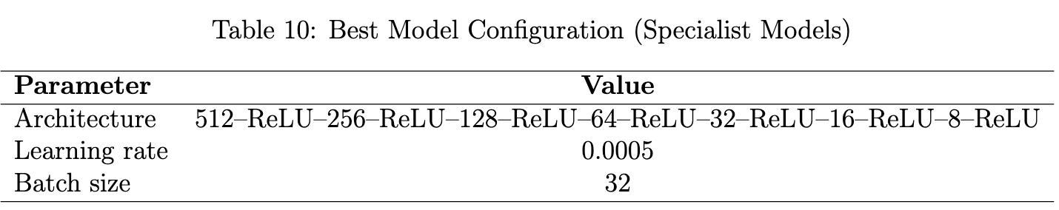
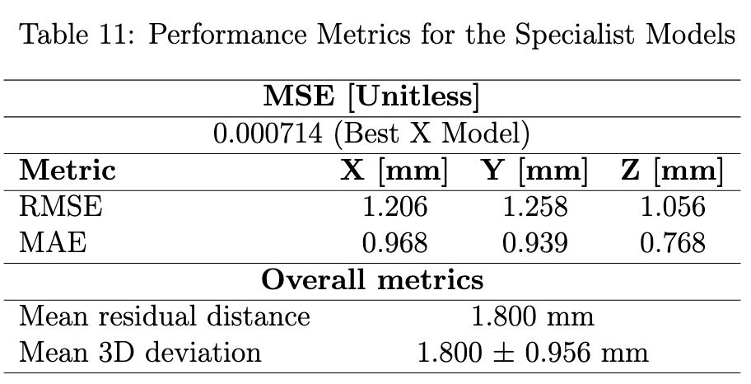
Expert Models per Coordinate

Slide 10
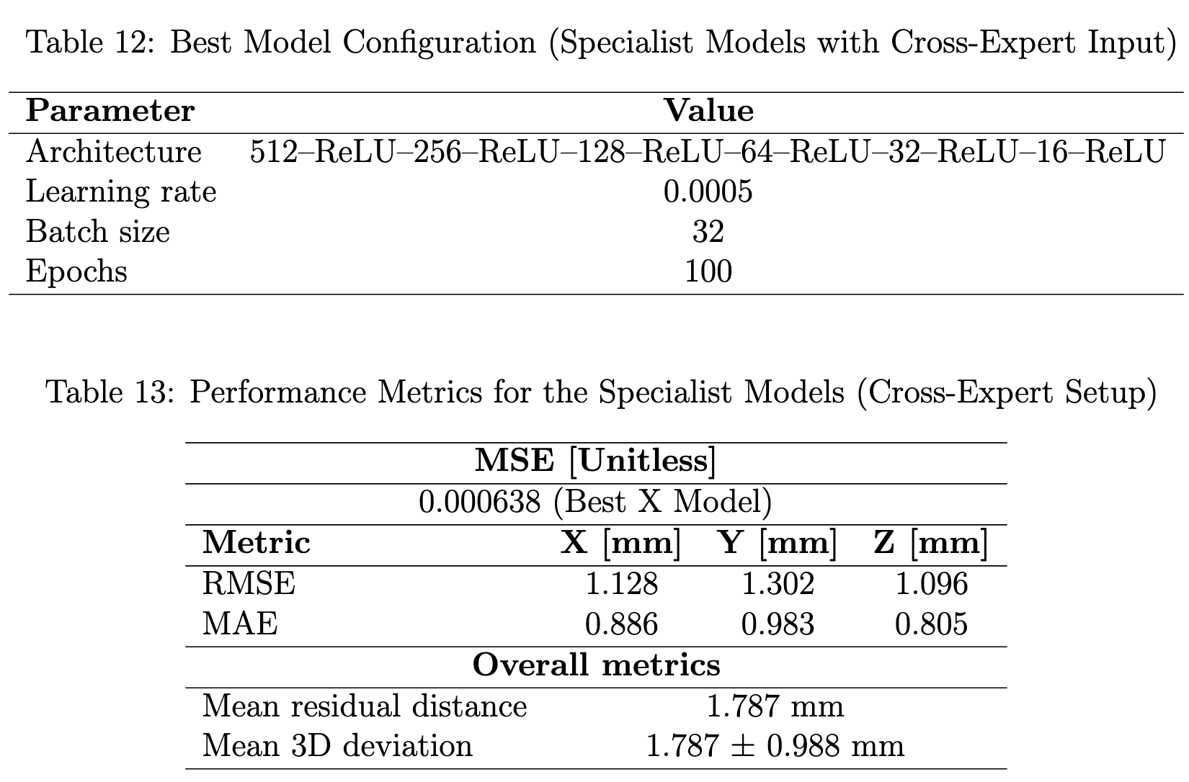
Specialist Models with Shared Inputs
👑

Slide 11
Knowledge Distillation + Quantization
Explored lightly in order to run a model directly on the current hardware
Shows slight increase in error
Given price, better to connect Raspberry Pi Zero 2 or 5
~18 - 70€
Enables training on edge
Better for development,

Slide 12
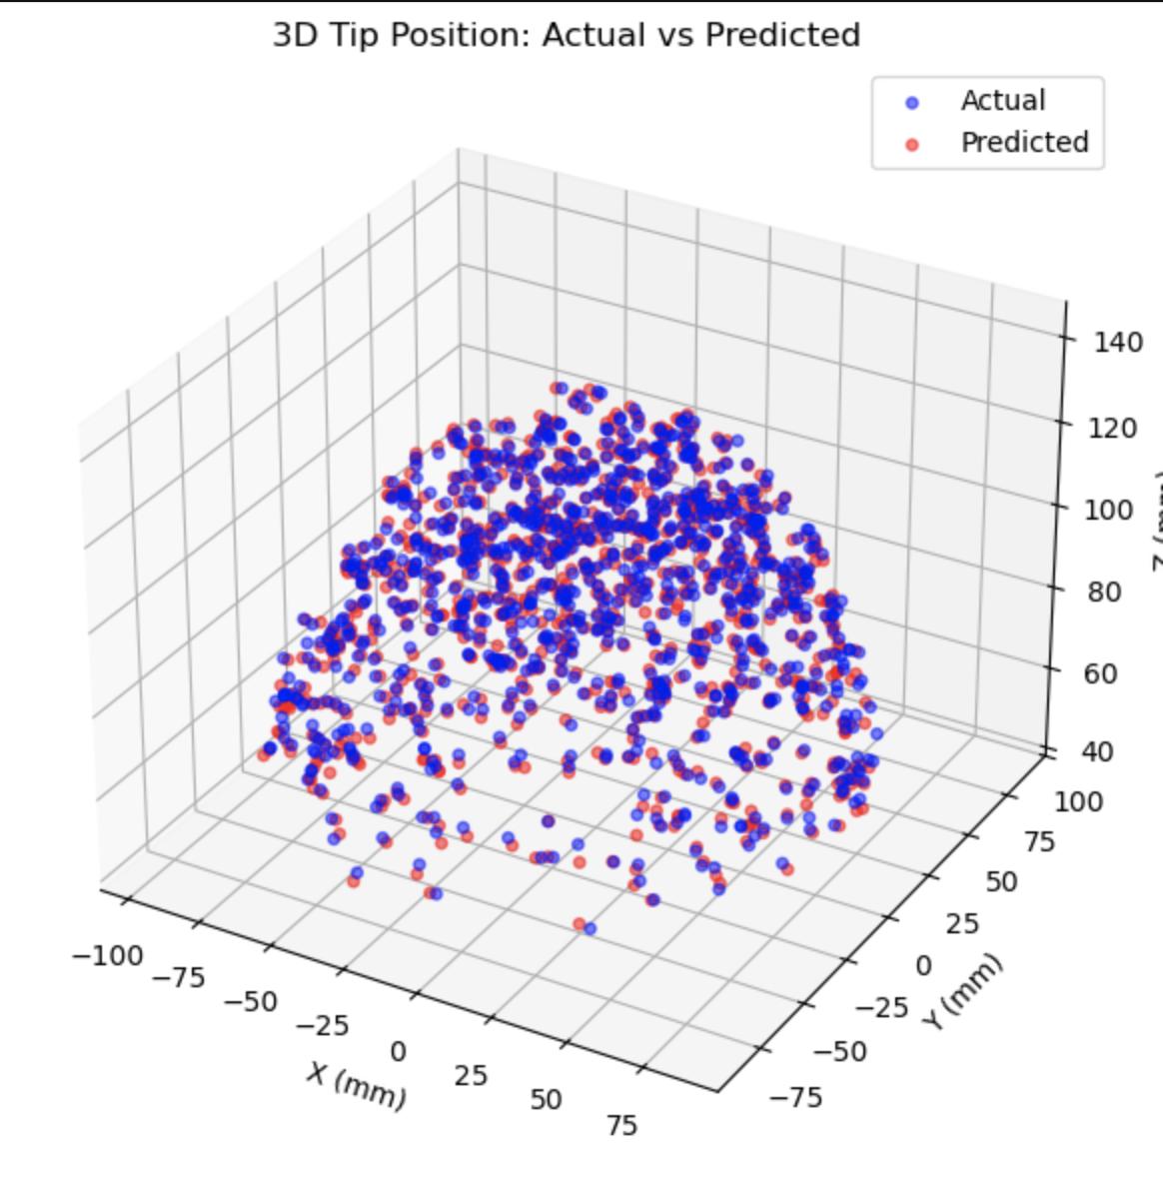
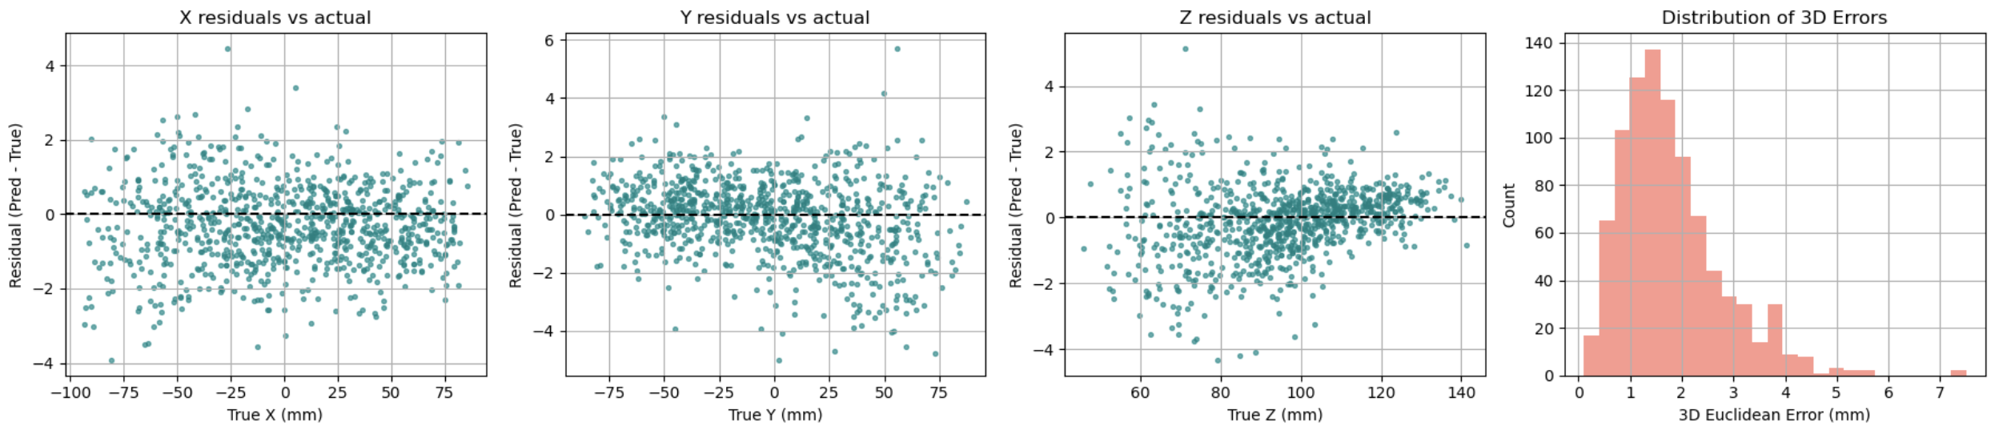
Conclusion

